Slide 1
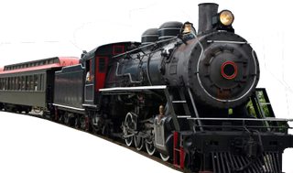
RAILWAY RESERVATION SYSTEM
COURSE BASED PROJECT

Slide 2


COURSE BASED PROJECT TEAM-11
20071A05B1 SOUMIKA MALLIDI
20071A05B2 SREYA TIRUMALARAJU
20071A05B3 TALLURI NIKHITHA DEVI
20071A05B4 TEJESWARA MURTHY PALWADI
20071A05B5 TELUGU SINDHU
21075A0512 VIKAS KAMARAPU

Slide 3
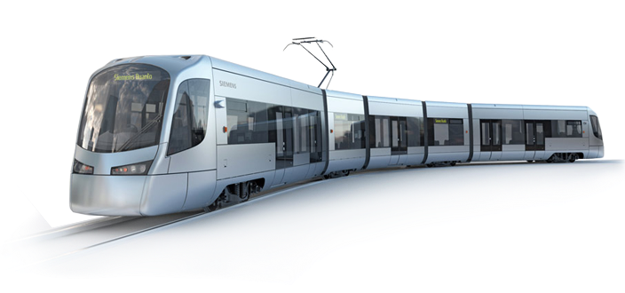
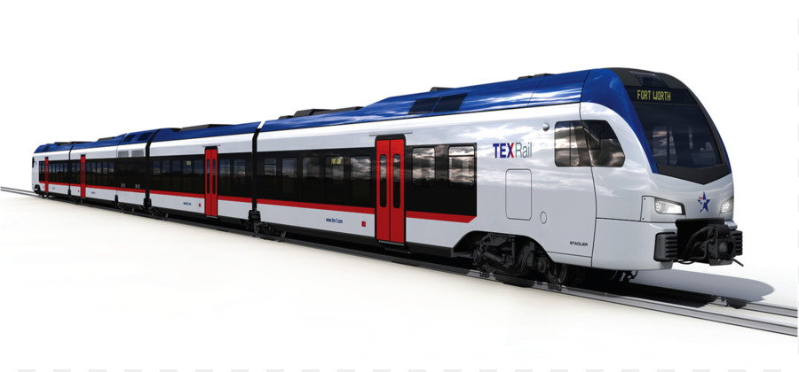
OUTLINE
ABSTRACT
PROBLEM DEFINITION
FEATURES
MODULES
FUTURE SCOPE
CONCLUSION
USER LOGIN
TICKET RESERVATION
TICKET CANCELATION
RAILWAY RESERVATION SYSTEM CODE

Slide 4
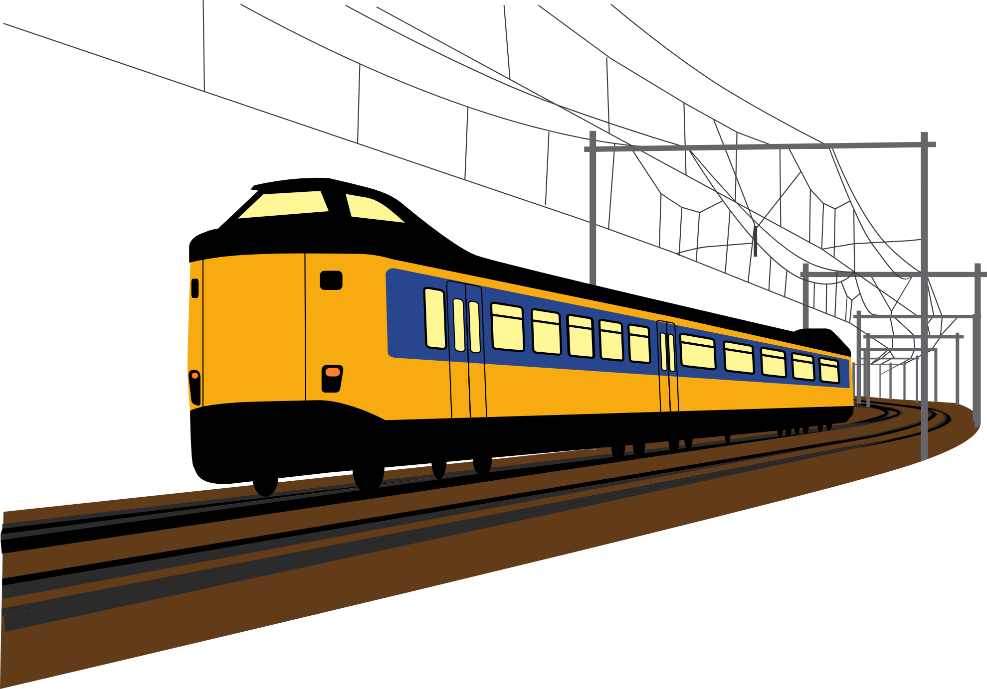
ABSTRACT
Railway ticket reservation will help the passengers to book their tickets for their journey, search train between two stations and get details of particular train schedules including their fare details.
To use this system, its users should be registered and should have a valid login and password to make their reservation. By choosing reservation of ticket, user has to enter the name, number of tickets and then choose by which train to travel according to their destination.
Then the system will ask for ticket confirmations. User can also view full list of all the trains available. After reserving a TICKET, you call also cancel your reservation.
Passengers will be provided with total fare charges and mode of payment which they want to select for making final payment.

Slide 5
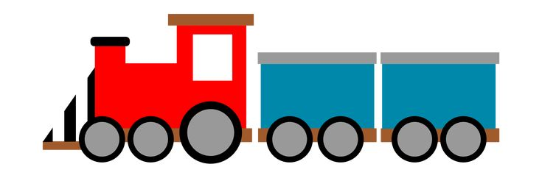
PROBLEM Definition
Software has to be developed for automating the manual reservation system of railway.
The existing system is highly manual involving a lot of paper work and calculation and therefore may be erroneous. This has lead to inconsistency and inaccuracy in the maintenance of data.
To Overcome this problem we have designed a Computerized system. The computerization of the reservation system will reduce a lot of paperwork and hence the load on the administrative staff.
These System should be designed to provide functionalities like booking of tickets as well as cancel the tickets in which a user should be able to applied for tickets of any train and of any class.
RAILWAY RESERVATION SYSTEM

Slide 6
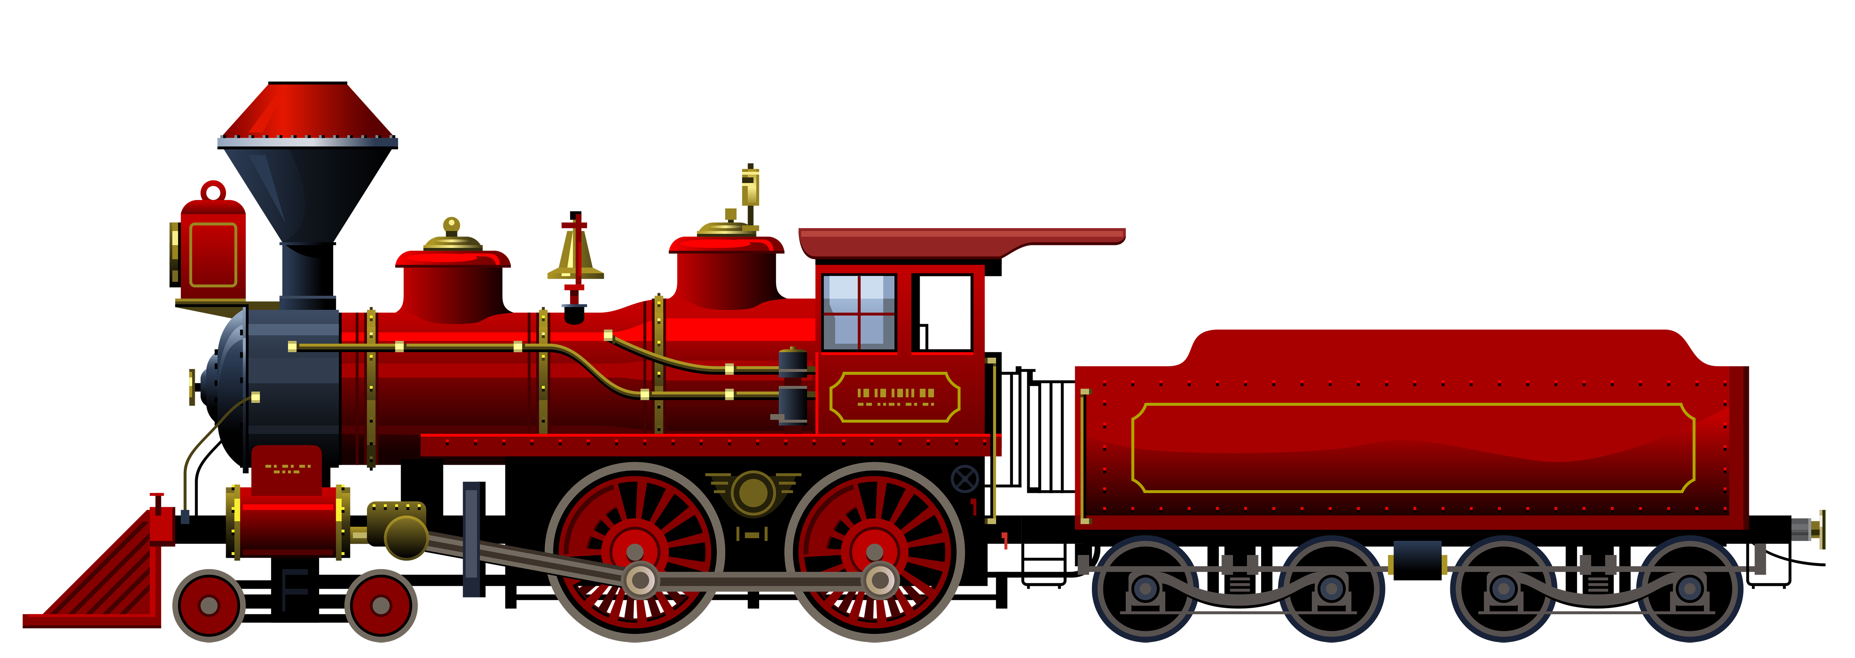
FEATURES
1) Searching of data is easy
2) Information is accurate
3) It is a fast process
4) Data efficiency is more
5) Data can also be accessed after the program.
RAILWAY RESERVATION SYSTEM

Slide 7
MODULES
We analyzed and concluded that the project can be implemented by following Modules:-
ADMIN LOGIN
USER LOGIN
TICKET RESERVATION
All TRAINS DATABASE
TICKET CANCELATION

Slide 8
FUTURE SCOPE
User defined security needs can be employed.
Records of client activities can be maintained.
In future , there would be a chance for Multi Login System.
Another improvement would be to add more features other than the existing modules to store the information in a more efficient way.

Slide 9
CONCLUSION
Our Program is encrypted by a Login Form.
We provide an easy handling system in which user can see Reservation of Tickets, View available Trains, Cancel the Booked tickets etc.
Customer can also view their Tickets after the execution of program.
The Main thing is that we can access user Data Base even after the execution of program with the help of File handling.

Slide 10
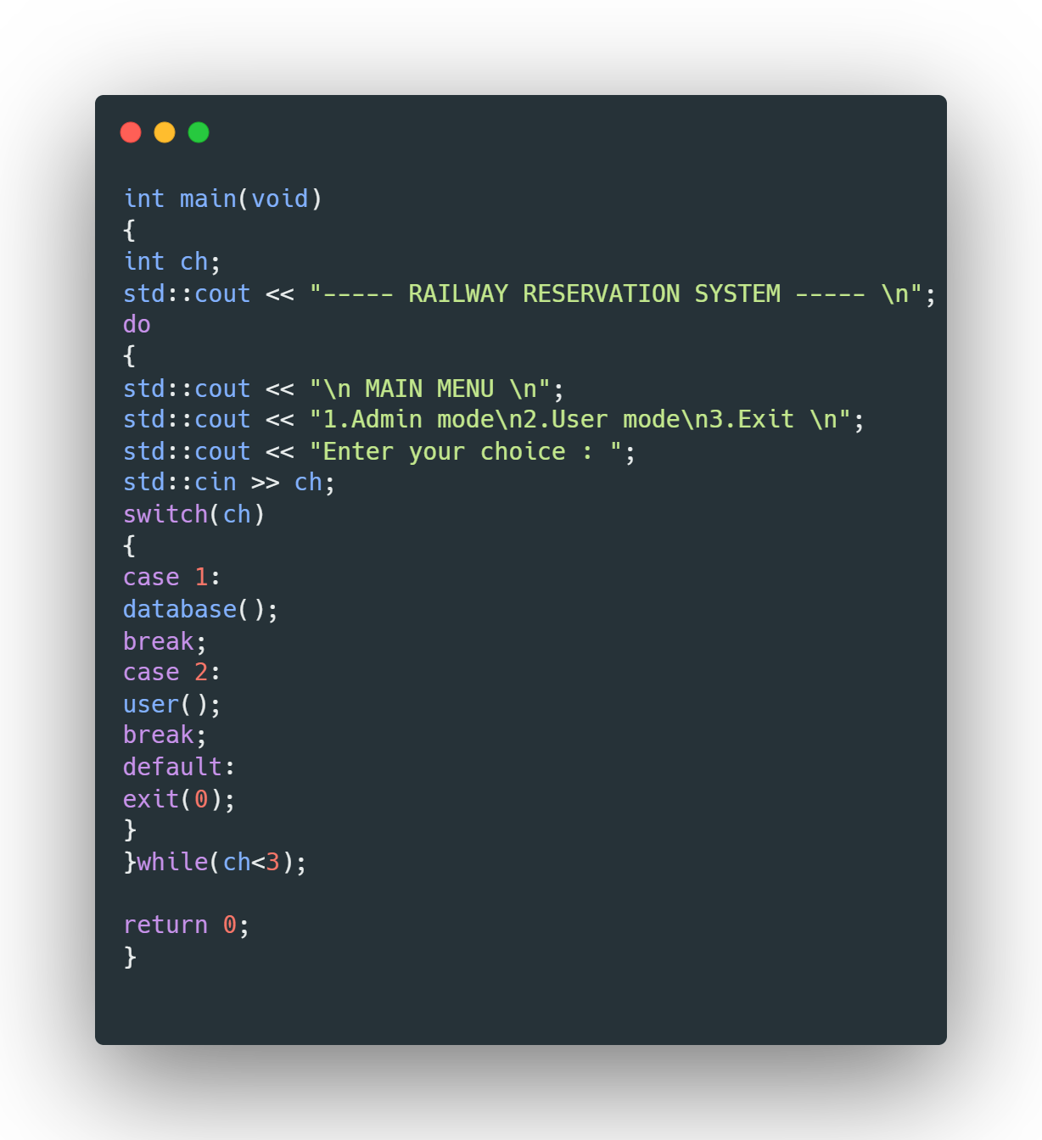
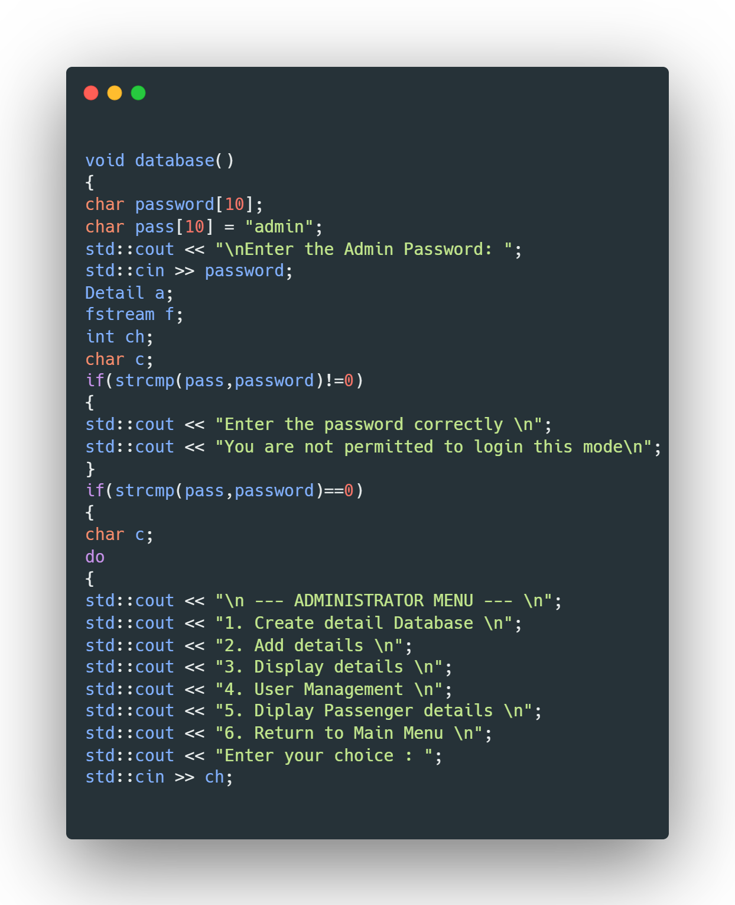
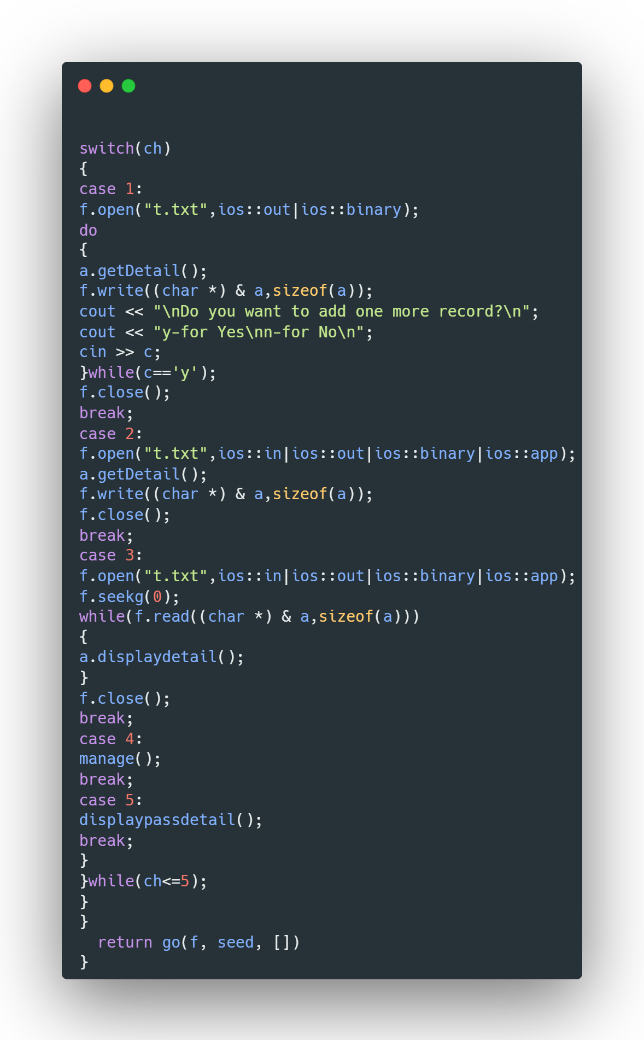
RAILWAY RESERVATION SYSTEM CODE

Slide 11
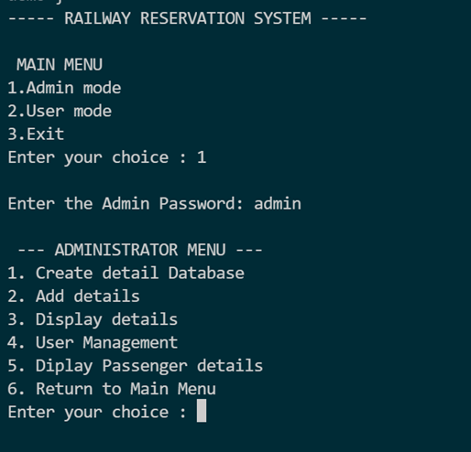
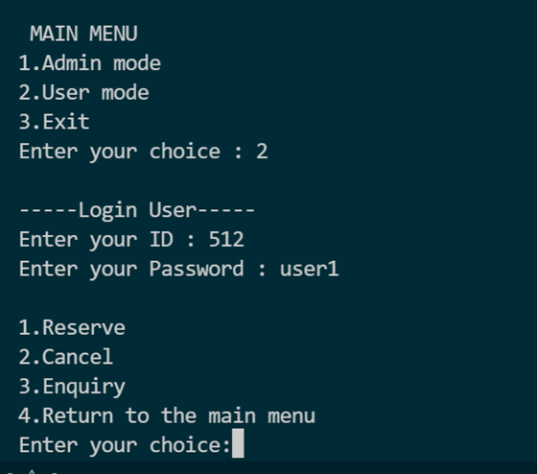
USER LOGIN

Slide 12
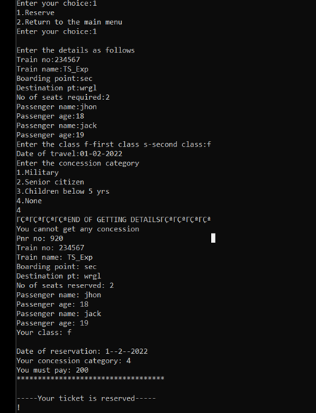
TICKET RESERVATION

Slide 13
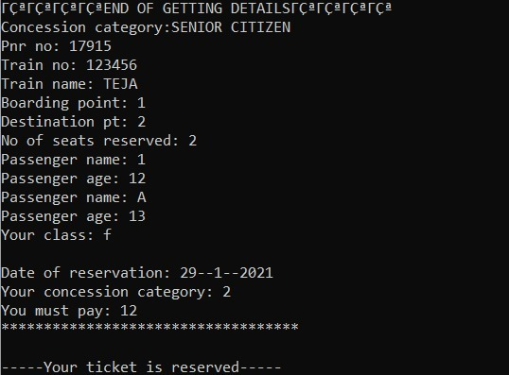
TICKET CANCELLATION

Slide 14
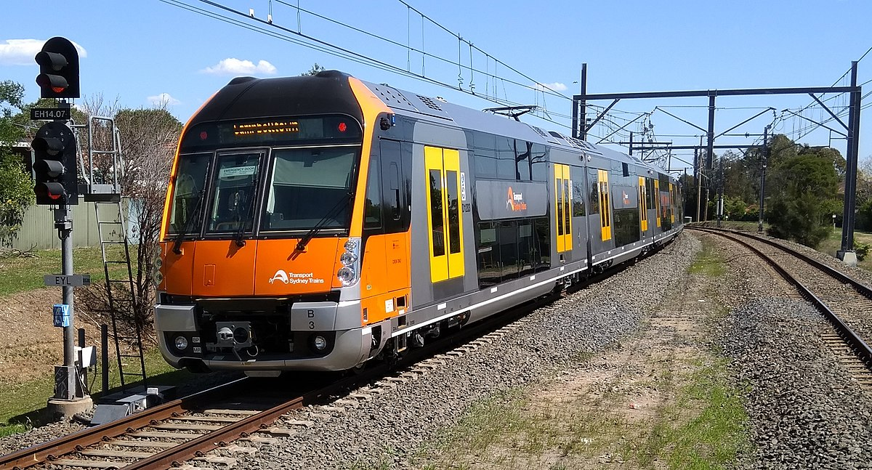
Thank you

